Slide 1
Computer Graphics 2:
Maths Preliminaries
Subhadip Basu, Ph.D
Dept. of CSE, Jadavpur University

Slide 2
Introduction
Computer graphics is all about maths!
None of the maths is hard, but we need to understand it well in order to be able to understand certain techniques
Today we’ll look at the following:
  Coordinate reference frames
  Points & lines
  Vectors
  Matrices

Slide 3
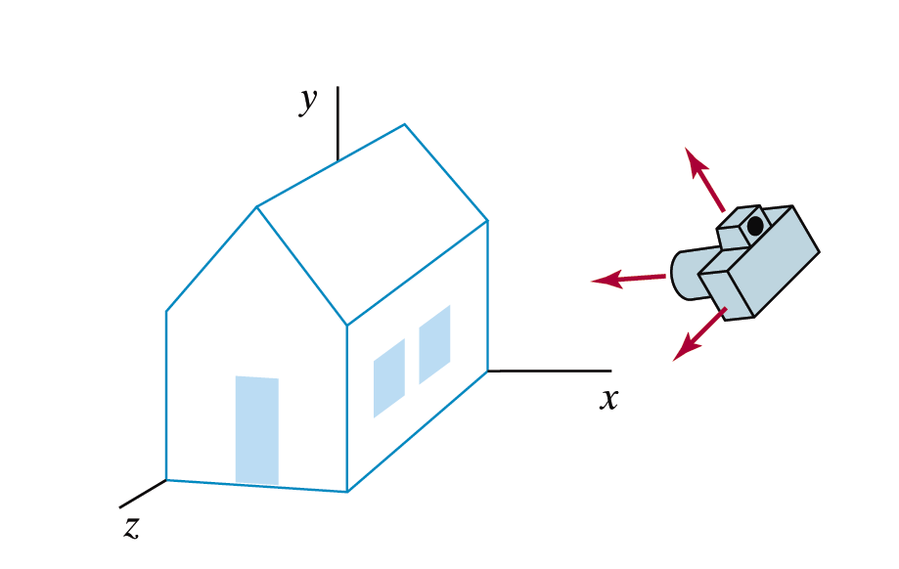

Big Idea
Images taken from Hearn & Baker, “Computer Graphics with OpenGL” (2004)

Slide 4
Coordinate Reference Frames – 2D
When setting up a scene in computer graphics we define the scene using simple geometry
For 2D scenes we use
simple two dimensional
Cartesian coordinates
All objects are defined
using simple coordinate
pairs
y axis
y
P
x
x axis

Slide 5
Coordinate Reference Frames – 2D (cont…)
y
(2, 7)
(7, 7)
7
3
(2, 3)
(7, 3)
x
2
7

Slide 6
Coordinate Reference Frames – 3D
For three dimensional scenes we simply add
an extra coordinate
y axis
y
P
z
x
z axis
x axis

Slide 7
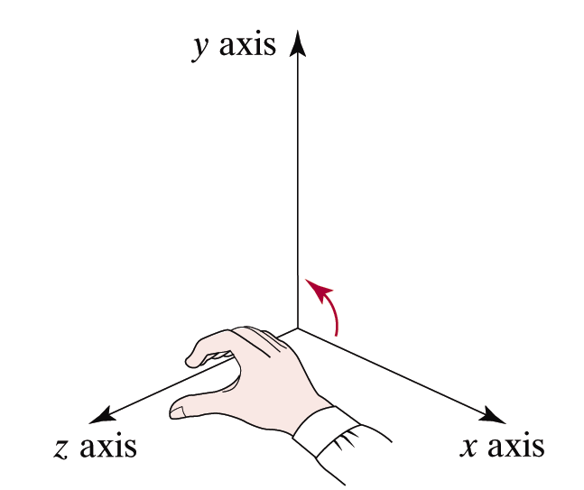
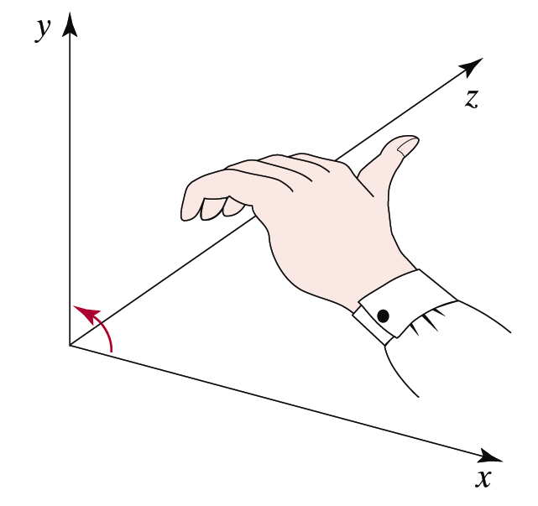
Left Handed Or Right Handed?
There are two different ways in which we can do 3D coordinates – left handed or right handed
We will mostly use the right-handed system
Images taken from Hearn & Baker, “Computer Graphics with OpenGL” (2004)
Right-Hand
Reference System
Left-Hand
Reference System

Slide 8
Points & Lines
Points:
  A point in two dimensional space is given as an ordered pair (x, y)
  In three dimensions a point is given as an ordered triple (x, y, z)
Lines:
  A line is defined using a start point and an end-point
    In 2d: (x_{start}, y_{start}) to (x_{end}, y_{end})
    In 3d: (x_{start}, y_{start} , z_{start}) to (x_{end}, y_{end} , z_{end})

Slide 9
Points & Lines (cont…)
y
(2, 7)
(6, 7)
The line from
(2, 7) to (7, 3)
(2, 3)
(7, 3)
(7, 1)
x

Slide 10
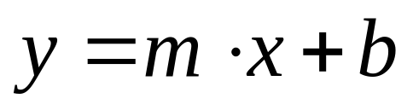
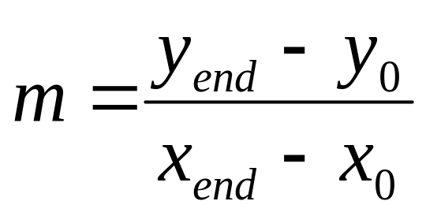
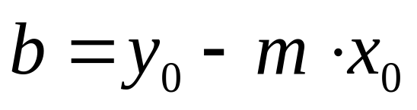
The Equation of A Line
The slope-intercept
equation of a line is:
where:
The equation of the line gives us the corresponding y point for every x point
y
y_{end}
y₀
x₀
x_{end}
x

Slide 11
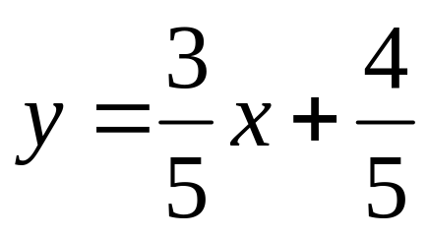
A Simple Example
Let’s draw a portion of the line given by the equation:
Just work out the y coordinate for each x coordinate

Slide 12
A Simple Example (cont…)
y
6
5
4
3
2
1
0
x
1
2
3
4
5
6
7
8
9
10

Slide 13
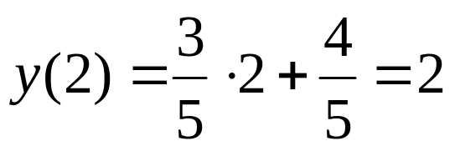
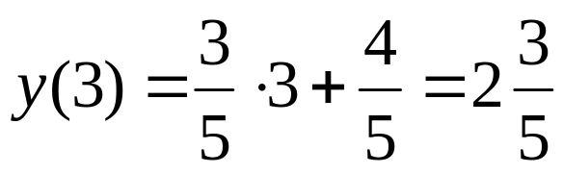
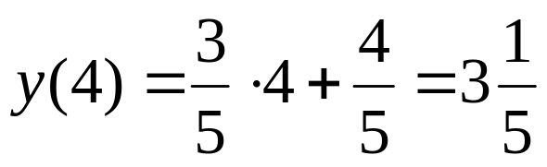
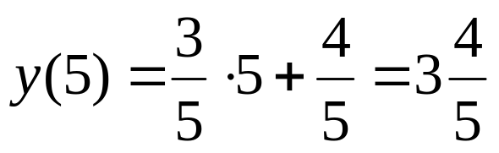
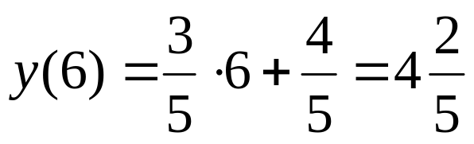
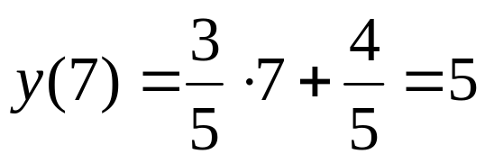
A Simple Example (cont…)
For each x value just work out the y value:
y
5
2
2
3
4
5
6
7
x

Slide 14
Vectors
Vectors:
  A vector is defined as the difference between two points
  The important thing is that a vector has a direction and a length
What are vectors for?
  A vector shows how to move from one point to another
  Vectors are very important in graphics - especially for transformations

Slide 15
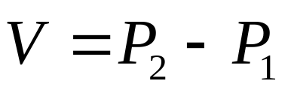
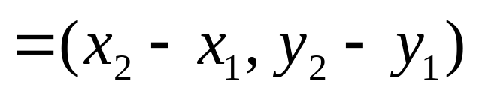
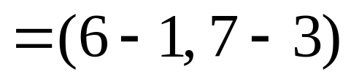
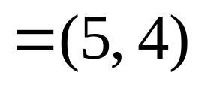
Vectors (2D)
To determine the vector between two points simply subtract them
P₂ (7, 10)
y axis
V
P₂ (6, 7)
P₂ (10, 7)
P₁ (2, 6)
V
V
P₁ (1, 3)
P₁ (5, 3)
x axis
WATCH OUT: Lots of pairs of points share the same vector between them

Slide 16

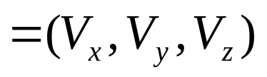
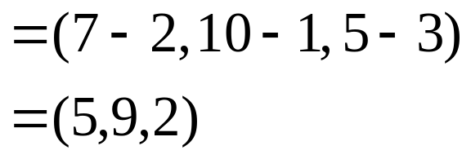
Vectors (3D)
In three dimensions a vector is calculated in much the same way
y axis
P₂
So for (2, 1, 3) to (7, 10, 5) we get
P₁
z axis
x axis

Slide 17
Vector Operations
There are a number of important operations we need to know how to perform with vectors:
  Calculation of vector length
  Vector addition
  Scalar multiplication of vectors
  Scalar product
  Vector product

Slide 18
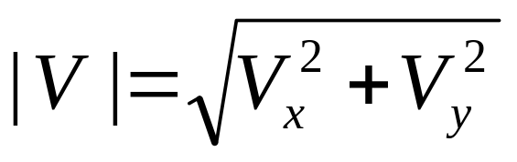
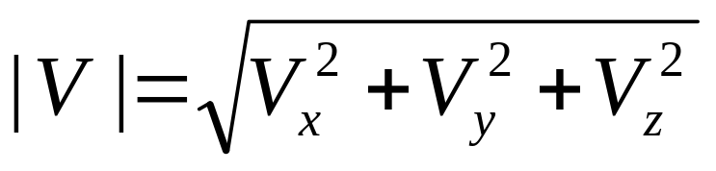
Vector Operations: Vector Length
Vector lengths are easily calculated in two dimensions:
and in three dimensions:

Slide 19
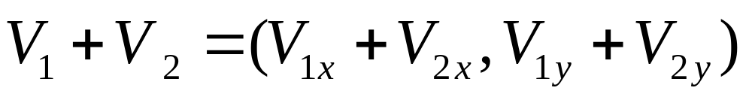
Vector Operations: Vector Addition
The sum of two vectors is calculated by simply adding corresponding components
Performed similarly in three dimensions
y axis
y axis
V₁ + V₂
V₂
V₂
V₁
V₁
x axis
x axis

Slide 20
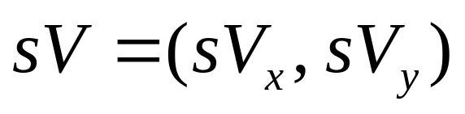
Vector Operations: Scalar Multiplication
Multiplication of a vector by a scalar proceeds by multiplying each of the components of the vector by the scalar
y axis
y axis
(sV_{x}, sV_{y})
(V_{x}, V_{y})
sV
V
x axis
x axis

Slide 21
Other Vector Operations
There are other important vector operations that we will cover as we come to them
These include:
  Scalar product (dot product)
  Vector product (cross product)

Slide 22

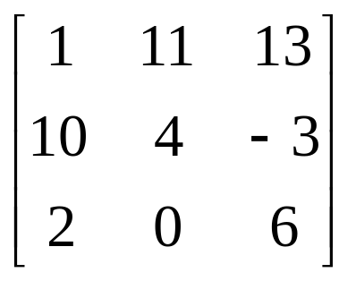
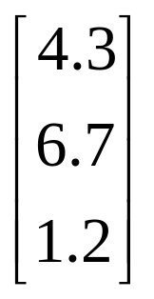
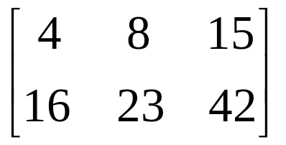

Matrices
A matrix is simply a grid of numbers
However, by using matrix operations we can perform a lot of the maths operations required in graphics extremely quickly

Slide 23
Matrix Operations
The important matrix operations for this course are:
  Scalar multiplication
  Matrix addition
  Matrix multiplication
  Matrix transpose
  Determinant of a matrix
  Matrix inverse

Slide 24
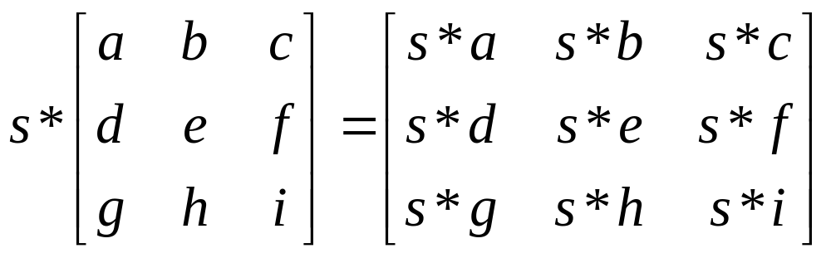
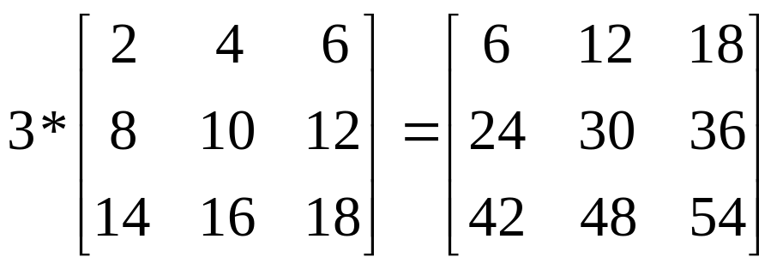
Matrix Operations: Scalar Multiplication
To multiply the elements of a matrix by a scalar simply multiply each one by the scalar
Example:

Slide 25
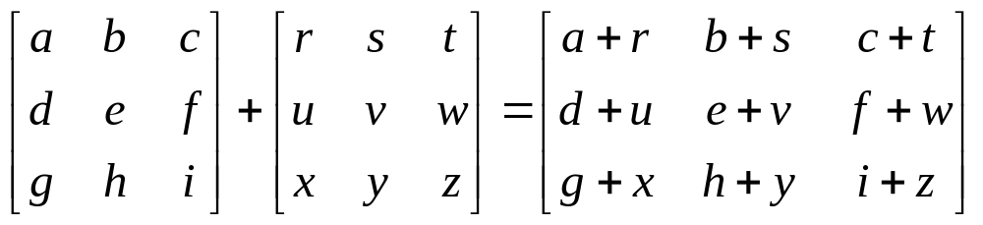
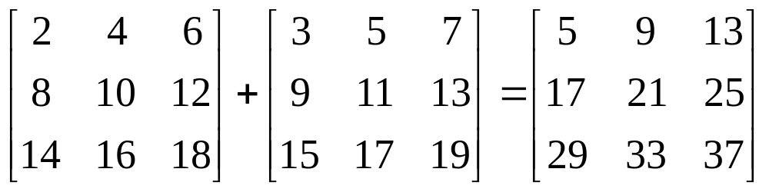
Matrix Operations: Addition
To add two matrices simply add together all corresponding elements
Example:
Both matrices have to be the same size

Slide 26
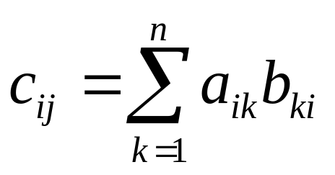
Matrix Operations: Matrix Multiplication
We can multiply two matrices A and B together as long as the number of columns in A is equal to the number of rows in B
So, if we have an m by n matrix A and a p by q matrix B we get the multiplication:
C=AB
where C is a m by q matrix whose elements are calculated as follows:

Slide 27
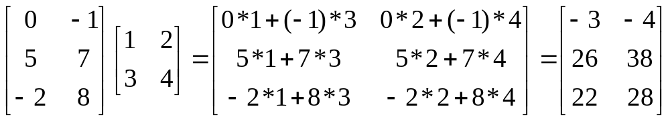
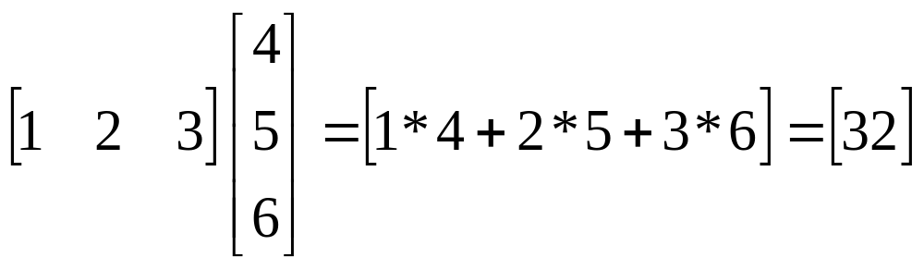
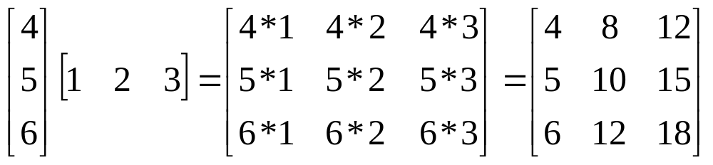
Matrix Operations: Matrix Multiplication (cont…)
Examples:

Slide 28

Matrix Operations: Matrix Multiplication (cont…)
Watch Out! Matrix multiplication is not commutative, so:

Slide 29
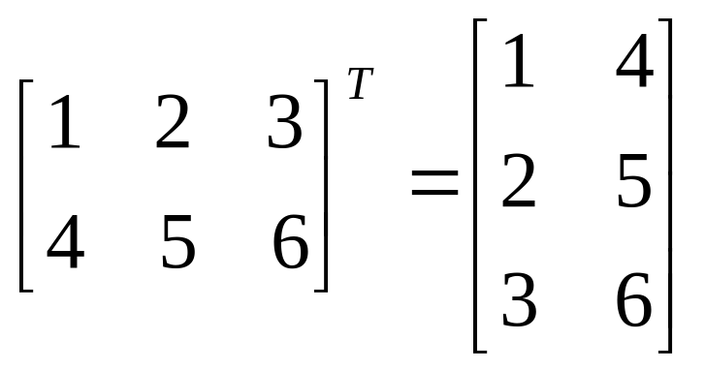
Matrix Operations: Transpose
The transpose of a matrix M, written as M^{T} is obtained by simply interchanging the rows and columns of the matrix
For example:

Slide 30
Other Matrix Operations
There are some other important matrix operations that we will explain as we need them
These include:
  Determinant of a matrix
  Matrix inverse

Slide 31
Summary
In this lecture we have taken a brief tour through the following:
  Basic idea
  The mathematics of points, lines and vectors
  The mathematics of matrices
These tools will equip us to deal with the computer graphics techniques that we will begin to look at, starting next time

Slide 32
Exercises 1
Plot the line y = ½x + 2 from x = 1 to x = 9
y
6
5
4
3
2
1
0
x
1
2
3
4
5
6
7
8
9
10

Slide 33
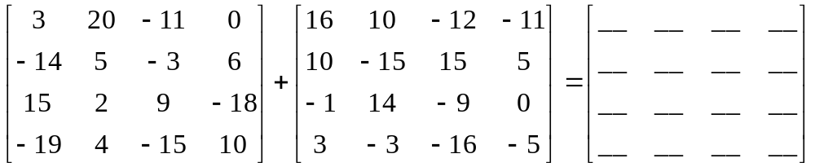
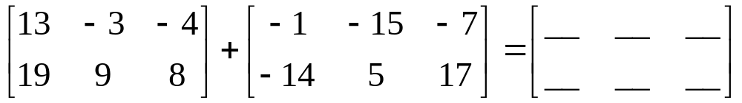
Exercises 2
Perform the following matrix additions:

Slide 34
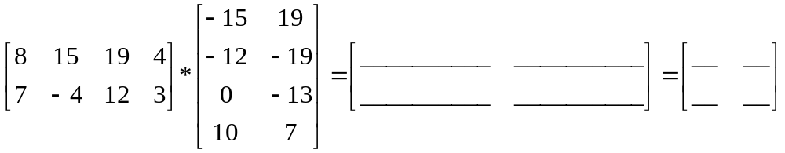
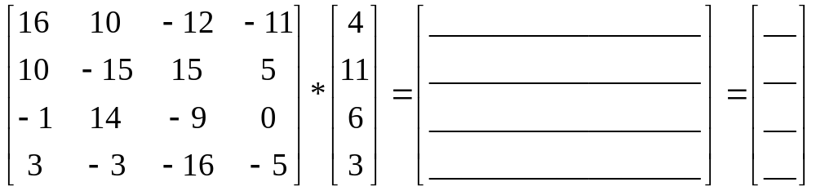
Exercises 3
Perform the following matrix multiplications:

Slide 35
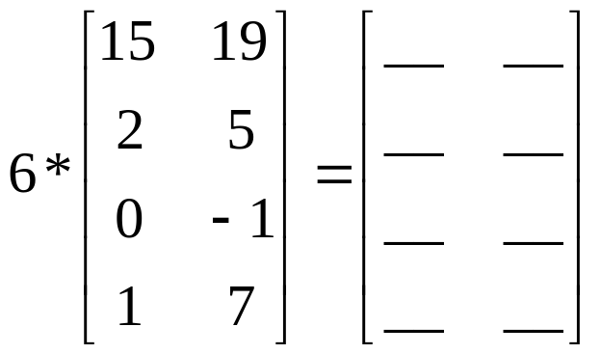
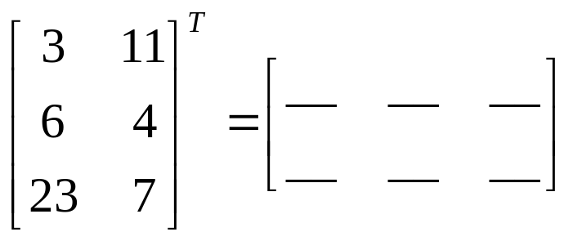
Exercises 4
Perform the following multiplication of a matrix by a scalar
Calculate the transpose of the following matrix

